Slide 1



Software Engineering
Richard Thomas
&
Liu Yixian

Slide 2
Course Content
Software Systems
Ethics
Lifecycle Models, Processes, Methods & Tools
Requirements
Object-Oriented Modelling, Analysis & Design
Implementation
Quality Assurance
Maintenance

Slide 3
Assumed Knowledge
OO Programming
  Build multi-class software

Slide 4
Textbook
Object-Oriented Software Engineering
  Stephen R. Schach
  McGraw Hill

Slide 5
Assessment
Tutorials
  Practice key concepts
Project
  Requirements Model
  Analysis & Design Model
  MVP Implementation
Final Exam
  Theory
  Application

Slide 6
Chapter 1- Introduction

Slide 7
Topics
Professional software development
  What is meant by software engineering
Software Crisis
  How successful is the discipline at delivering software?
Software engineering ethics
  Brief introduction to ethical issues that affect software engineering

Slide 8
Software Engineering
Software engineering is both exciting and frustrating
Exciting because it draws on many technical disciplines and provides a harness that binds each discipline to the next
Frustrating, because it demands knowledge in a multitude of topic areas and seems to be infinitely expandable
  Roger Pressman, 1992

Slide 9
Software Engineering
Economies of ALL developed nations depend on software
Software is pervasive
Software engineering is concerned with
  theories,
  methods and
  tools
for professional software development
Expenditure on software represents a significant fraction of GNP in all developed countries
Notes:
Get students to list all the software enabled systems that they use every day.

Slide 10
Software Engineers
Choose appropriate tools & techniques
Work effectively in a team
Manage own work and the process

Slide 11
Software Costs
Often dominate computer system costs
  Cost of software on a PC is often greater than the hardware cost
Software costs more to maintain than it does to develop
  Long lived systems, the maintenance costs may be several times development costs
Software engineering is concerned with cost-effective software development

Slide 12
Software Project Failure
Increasing system complexity
  As new software engineering techniques help us to build larger, more complex systems, the demands change. Systems have to be built and delivered more quickly; larger, even more complex systems are required; systems have to have new capabilities that were previously thought to be impossible.
Failure to use software engineering methods
  It is fairly easy to write computer programs without using software engineering methods and techniques. Many companies have drifted into software development as their products and services have evolved. They do not use software engineering methods in their everyday work. Consequently, their software is often more expensive and less reliable than it should be.

Slide 13
Professional Software Development

Slide 14
Frequently Asked Questions
Question | Answer
What is software? | Computer programs and associated documentation. Software products may be developed for a particular customer or may be developed for a general market.
What are the attributes of good software? | Good software should deliver the required functionality and performance to the user and should be maintainable, dependable and usable.
What is software engineering? | Software engineering is an engineering discipline that is concerned with all aspects of software production.
What are the fundamental software engineering activities? | Software specification, software development, software validation and software evolution.
What is the difference between software engineering and computer science? | Computer science focuses on theory and fundamentals; software engineering is concerned with the practicalities of developing and delivering useful software.
What is the difference between software engineering and system engineering? | System engineering is concerned with all aspects of computer-based systems development including hardware, software and process engineering. Software engineering is part of this more general process.

Slide 15
Frequently Asked Questions
Question | Answer
What are the key challenges facing software engineering? | Coping with increasing diversity, demands for reduced delivery times and developing trustworthy software.
What are the costs of software engineering? | Roughly 60% of software costs are development costs, 40% are testing costs. For custom software, evolution costs often exceed development costs.
What are the best software engineering techniques and methods? | While all software projects have to be professionally managed and developed, different techniques are appropriate for different types of system. For example, games should always be developed using a series of prototypes whereas safety critical control systems require a complete and analyzable specification to be developed. You can’t, therefore, say that one method is better than another.
What differences has the web made to software engineering? | The web has led to the availability of software services and the possibility of developing highly distributed service-based systems. Web-based systems development has led to important advances in programming languages and software reuse.

Slide 16
Software Products
Generic
  Stand-alone systems marketed and sold to customers
  e.g. PC software such as graphics programs, project management tools; CAD software; software for specific markets such as appointments systems for dentists
Customised (Bespoke)
  Commissioned by a specific customer to meet their needs
  e.g. Embedded control systems, air traffic control software, traffic monitoring systems

Slide 17
Product Specification
Generic
  Specification of what the software should do is owned by the software developer and decisions on software change are made by the developer
Customised (Bespoke)
  Specification of what the software should do is owned by the customer for the software and they make decisions on software changes that are required.

Slide 18
Attributes of Good Software
Product Characteristic | Description
Maintainability | Software should be written in such a way so that it can evolve to meet the changing needs of customers. This is a critical attribute because software change is an inevitable requirement of a changing business environment.
Dependability & Security | Software dependability includes a range of characteristics including reliability, security and safety. Dependable software should not cause physical or economic damage in the event of system failure. Malicious users should not be able to access or damage the system.
Efficiency | Software should not make wasteful use of system resources such as memory and processor cycles. Efficiency therefore includes responsiveness, processing time, memory utilisation, etc.
Acceptability | Software must be acceptable to the type of users for which it is designed. This means that it must be understandable, usable and compatible with other systems that they use.

Slide 19



Software Development is Not Just Writing Code
It is problem solving
  Understanding a problem
  Proposing a solution and plan
  Engineering a system based on the proposed solution using a good design
It is dealing with complexity
  Creating abstractions and models
It is knowledge management
  Requirements elicitation, analysis, design, & validation
It is rationale management
  Design decisions need to be known by all stakeholders
Notes:
Rubic Cube blindfolded http://www.youtube.com/watch?v=JCkI2qh1SF4&NR=1
Rubic Cube in 6 seconds: http://www.youtube.com/watch?v=jI_zjWssn2g&feature=related
Rubic cube by a 3 year old,
2 Rubic Cubes at the same time: http://www.youtube.com/watch?v=RW3akfdEGI8&feature=related
3 Rubic Cubes in a row: http://www.youtube.com/watch?v=api7yyAoAug&feature=channel

Slide 20
Software & Creativity
Software development is a creative act
  not a repetitive act of manufacturing
Software development invariants (constants)
  complexity
  conformity
  changeability
  invisibility
No ‘silver bullets’

Slide 21
Software Engineering
An engineering discipline concerned with all aspects of software production from the early stages of system specification through to maintaining the system after it has gone into use.
Engineering discipline
  Using appropriate theories and methods to solve problems bearing in mind organisational and financial constraints.
All aspects of software production
  Not just technical process of development. Also project management and the development of tools, methods etc. to support software production.

Slide 22
Importance of Software Engineering
Individuals and society rely on software systems
  We need to be able to produce reliable and trustworthy systems economically and quickly
It is usually cheaper, in the long run, to use software engineering methods and techniques for software systems rather than just write the programs as if it was a personal programming project
  For many systems, changing the software after it has gone into use is the largest part of the cost

Slide 23
Software Engineering Process
Structured set of activities followed to develop a software system
  States an order for carrying out activities
  Specifies what development artifacts are to be delivered and when
  Assigns activities and artifacts to developers
  Offers criteria for monitoring a project’s progress, for measuring the outcomes, and for planning future projects
Notes:
The process aims at managing and improving collaboration in the development and maintenance team so that a quality product is delivered to the customers and it is properly supported afterwards.
Unlike modeling and programming languages, software processes are not susceptible to standardization. Each organization has to develop its own process model or customize it from a generic process template, such as the template known as the Rational Unified Process (RUP) (Kruchten, 1999). A software process is an important part of the organization’s overall business process and determines the organization’s unique character and competitive position in the market place.
The process adopted by an organization must be aligned with its development culture, social dynamics, developers’ knowledge and skills, managerial practices, customers’ expectations, project sizes, and even kinds of application domains. Because all these factors are subject to change, an organization may need to diversify its process model and create variants of it for each software project. For example, depending on the developers’ familiarity with the modeling methods and tools, special training courses may need to be included in the process.
Project size has probably the greatest influence on the process. In a small project (of ten or so developers), a formal process may not be needed at all. Such a small team is likely to communicate and respond to changes informally. In larger projects, an informal communication network will not suffice and a well-defined process for controlled development is necessary.

Slide 24
Techniques, Methodologies and Tools
Techniques
  Formal procedures for producing results using some well-defined notation
Methodologies
  Collection of techniques applied across software development and unified by a philosophical approach
Tools
  Instruments or automated systems to accomplish a technique
  Interactive Development Environment (IDE)
  Generative AI tools & agents
Notes:
Techniques are well known procedures that you know will produce a result (Algorithms, cookbook recipes are examples of techniques).
Some people use the word “method” instead of technique, but this word is already reserved in our object-oriented development language, so we won’t use it here.
A collection of techniques is called a methodology. (A cookbook is a methodology).
A Tool is an instrument that helps you to accomplish a method. Examples of tools are: Pans, pots and stove.
Note that these weapons are not enough to make a really good sauce. That is only possible if you are a good cook. In our case, if you are a good software engineer.
Techniques, methodologies and tools are the domain of discourse for computer scientists as well. What is the difference?

Slide 25
Software Process Activities
Specification: Customers and engineers define the software to be produced and its operating constraints
Development: Software is designed and programmed
Validation: Software is checked to ensure that it is what the customer requires
Evolution: Software is modified to reflect changing customer and market requirements

Slide 26
Software Engineering Practice
    Understand the problem
  Communication and analysis
    Plan a solution
  Modeling and software design
    Carry out the plan
  Code generation
    Examine result for accuracy
  Testing & quality assurance

Slide 27
Understand the Problem
Who does it impact?
  Stakeholders
What are the unknowns?
  What data, functions, and features are required to properly solve the problem?
Can the problem be compartmentalised?
  Can it be broken into smaller problems that may be easier to understand?

Slide 28
Plan a Solution
Have you seen similar problems before?
  Are there recognisable patterns for a potential solution?
  Are there existing services that implement some of the data, functions, and features?
Can subproblems be defined?
  Are there apparent solutions for the subproblems?

Slide 29
Carry Out the Plan
Implement the solution
  Write code
  Use AI tools
Does the solution conform to the plan?
  Is source code traceable to the design?
Is each part of the solution provably correct?
  Has the design and code been reviewed?
  Or better, have correctness proofs been applied to algorithm?

Slide 30
Examine the Result
Is it possible to test each component part of the solution?
  Has a reasonable testing strategy been implemented?
  AI tools can generate tests
    Need to be validated
Does the solution produce results, that conform to the data, functions, and features that are required?
  Has the software been validated against all stakeholder requirements?

Slide 31
Hooker - Thomas Software Principles
The Reason It All Exists – Provide value to users
K I S S (Keep It Simple, Stupid!) – Design as simple as possible
Maintain the Vision – Clear vision is essential
  Focus on delivering value, not every possible user wish
What You Produce, Others Will Consume
  Eat your own dog food – Use the software
    Experience the user’s pain
Be Open to the Future – Do not design yourself into a corner
Think! – Thought before action produce results

Slide 32
General Issues that Affect Software
Heterogeneity
  Increasingly, systems are required to operate as distributed systems across networks that include different types of computer and mobile devices.
Business and social change
  Business and society are changing incredibly quickly as emerging economies develop and new technologies become available. They need to be able to change their existing software and to rapidly develop new software.
    Problem is often ambiguous and requirements are unclear

Slide 33
General Issues that Affect Software
Security and trust
  As software is intertwined with all aspects of our lives, it is essential that we can trust that software.
Scale
  Software has to be developed across a very wide range of scales, from very small embedded systems in portable or wearable devices through to Internet-scale, cloud-based systems that serve a global community.

Slide 34
Software Engineering Diversity
Many types of software system
  No universal set of software techniques applicable to all of them
The software engineering methods and tools used depend on the type of application being developed, the requirements of the customer and the background of the development team

Slide 35
Application Types
Stand-alone applications
  Run on a local computer, such as a PC. Include all necessary functionality and do not need to be connected to a network.
Interactive transaction-based applications
  Execute on a server and are accessed by users from their own devices. Includes web applications such as e-commerce applications. Many mobile apps fall into this category.
Embedded control systems
  Control and manage hardware devices. Numerically, there are more embedded systems than any other type of system.
Notes:
Get students to identify a few software sys

Slide 36
Application Types
Batch processing systems
  Business systems that are designed to process data in large batches. They process large numbers of individual inputs to create corresponding outputs.
Entertainment systems
  Primarily for personal use and which are intended to entertain the user.
Systems for modelling and simulation
  Developed by scientists and engineers to model physical processes or situations, which include many, separate, interacting objects.
Notes:
Get students to identify a few software systems for each type.

Slide 37
Application Types
Data collection systems
  Collect data from their environment using a set of sensors and send that data to other systems for processing.
Systems of systems
  Systems composed of a number of other software systems.
Notes:
Get students to identify a few software systems for each type.
Ask students what application type AI falls into.
Gen AI and Agents
Robotics
Machine Learning

Slide 38
Software Engineering Fundamentals
Some fundamental principles apply to all types of software system, irrespective of the development techniques used:
  Systems should be developed using a managed and understood development process. Of course, different processes are used for different types of software.
  Dependability and performance are important for all types of system.
  Understanding and managing the software specification and requirements (what the software should do) are important.
  Where appropriate, you should reuse software that has already been developed rather than write new software.

Slide 39
Internet Software Engineering
Software services allow application functionality to be accessed over the web or by mobile apps
  Becoming dominant distribution method
Cloud computing is an approach to the provision of computer services where applications run remotely on the ‘cloud’
  Users do not buy hardware and software
    Pay according to use

Slide 40
Internet Software Engineering
Complex distributed systems
  Fundamental principles of software engineering are as applicable to them as they are to any other types of system

Slide 41
Internet Software Engineering
Software reuse
  Software reuse is the dominant approach for constructing internet-based systems
  When building these systems, you use
    Frameworks
    Pre-existing components
    Pre-existing services
      SaaS
Incremental and agile development
  Internet-based systems should be delivered incrementally
    Generally recognised that it is impractical to specify all the requirements for such systems in advance
      User needs change during development

Slide 42
Internet Software Engineering
Service-oriented systems
  Software may be implemented using service-oriented software engineering, where the software components are stand-alone web services
    Commonly called “microservices” now
Rich interfaces
  JavaScript, AJAX and HTML5 allow creation of rich interfaces within a web browser

Slide 43
Software Crisis?
70% of software projects fail
(The Standish Group Chaos Report, 2015)
An exaggeration?
Notes:
Last report that I paid for was 2015.
Standish group has been claiming the 70% failure rate for a few decades now.

Slide 44
Software Success
 | 2011 | 2012 | 2013 | 2014 | 2015
Successful | 29% | 27% | 31% | 28% | 29%
Challenged | 49% | 56% | 50% | 55% | 52%
Failed | 22% | 17% | 19% | 17% | 19%
Standish Chaos Report
Reading
  The Non-Existent Software Crisis: Debunking the Chaos Report
    Scott Ambler
Notes:
Note that the Standish group counts Challenged as “failed” when promoting the Chaos report and their consulting services.

Slide 45
Project Size & Success
Size | Successful | Challenged | Failed
Grand | 2% | 7% | 17%
Large | 6% | 17% | 24%
Medium | 9% | 26% | 31%
Moderate | 21% | 32% | 17%
Small | 62% | 16% | 11%
Standish Chaos Report, 2011 - 2015

Slide 46
Project Size & Success
Size | Method | Successful | Challenged | Failed
All | Agile | 39% | 52% | 9%
 | Waterfall | 11% | 60% | 29%
Large | Agile | 18% | 59% | 23%
 | Waterfall | 3% | 55% | 42%
Medium | Agile | 27% | 62% | 11%
 | Waterfall | 7% | 68% | 25%
Small | Agile | 58% | 38% | 4%
 | Waterfall | 44% | 45% | 11%
Standish Chaos Report, 2011 - 2015

Slide 47
Is There a Crisis?
Qld Health – Security “patch” lost medical records
Commonwealth Bank – Upgrade duplicated debits
Amadeus – Airport check-in unavailable around the world
Google Nest – Update caused battery to drain
  Could not control temperature on coldest weekend of the year
Nissan – Airbag sensor couldn’t detect if adult was in seat
  3.5M cars recalled
National Health Service (UK)
  Initial estimate was ₤2.4B
  Updated to ₤12.4B, after 4 years
  Final cost over ₤20B, before being cancelled

Slide 48
Software Crisis in Health?
Welsh NHS, Jan. 2018
  Could not access patient records
England NHS, May 2017
  WannaCry Ransomware
    due to outdated environments (Windows 8 & XP)
Qld Health, May 2017
  Security patch ‘lost’ medical records
    > 2 weeks to recover
Notes:
Qld. Health patch was to deal with WannaCry ransomware threat. Rush to implement and poor testing resulted in error. Patch was on a new system that had only been installed in May 2016.
Cairns Base Hospital worst affected, and had most opposition to adopting new system in 2016. Cairns had to call in all available off-duty medical staff to deal with problems.
PA, Lady Cilento, McKay and Townsville also affected.

Slide 49

Software Crisis in Banking?
Commonwealth Bank, Oct. 2024
  Duplicated debit transactions
    after upgrade
Bangladesh Bank, Feb. 2016
  $81M successfully stolen – software security faults
    $870M cancelled due to thieves spelling mistake
Notes:
CMB – Debits recurred multiple times

Slide 50
Software Crisis in Travel?
British Airways, May 2017
  Global IT failure (6th time in 2017)
    1000 flights & 75,000 passengers affected
Amadeus airport check-in, Sept. 2017
  7 airlines at 7 airports in 6 countries
    many others had short glitches
American Airlines, Dec. 2017
  Scheduling system bug allowed most pilots to take holidays in Christmas week
    15,000 flights would have been affected

Slide 51
Software Crisis in IoT?
Google Nest, Jan. 2016
  Software update caused battery to drain
    could not control temperatures on coldest weekend
Hive Thermostat in UK, Feb. 2016
  Software update set temperature to 32°C
    reset back to 32°C after customer changes

Slide 52
Software Crisis in Transportation?
Nissan, 2015
  Airbag sensor couldn’t detect if adult was in seat
    3.5M cars recalled
Fiat / Chrysler, May 2016
  Disabled airbags and seatbelts
    > 1M trucks recalled & at least one death
Dodge Ram, 2016
  Airbags and seatbelts failed if truck rolled
    1.25M trucks recalled

Slide 53
NHS in UK
10 years until cancelled
Initial estimate: ₤2.4B
  updated after 4 years to ₤12.4B
Final cost: over ₤20B ($200B RMB)
  Bolivia’s GDP is almost ₤20B

Slide 54
Queensland Health Payroll
Started Dec. 2007
Due July 2008
  Delivered March 2010
Initial estimate: $7M
  Final cost: $102M
Complete failure
  Cost to fix:
    over $800M
      so far …
    years left until fixed
      at another $400M+
  Staff over & under paid
    for over a year
    over payments cost $62M
Notes:
http://www.healthpayrollinquiry.qld.gov.au/
http://www.parliament.qld.gov.au/Documents/TableOffice/TabledPapers/2010/5310T2081.pdf
http://www.computerworld.com.au/article/393394/shared_services_learning_lessons_from_queensland_wa/
http://payrollnews.com.au/AnnouncementRetrieve.aspx?ID=52706
http://www.couriermail.com.au/news/queensland/queensland-health-payroll-will-cost-up-to-220-million-to-fix-acting-director-general-admits/story-e6freoof-1226094095536
http://www.couriermail.com.au/news/queensland/health-pay-bungle-bill-soars/story-e6freoof-1226178920932
http://news.smh.com.au/breaking-news-national/qld-wont-chase-qh-payroll-overpayments-20110710-1h8h7.html
http://www.brisbanetimes.com.au/queensland/lnp-demands-health-payroll-paper-trail-20120508-1yahx.html
http://www.theaustralian.com.au/national-affairs/state-politics/queensland-health-payroll-at-point-of-critical-vulnerability/story-e6frgczx-1226599862679
http://www.smh.com.au/it-pro/government-it/former-ibm-top-man-showed-no-bias-inquiry-20130321-2ggyq.html

Slide 55
Queensland Health Payroll
Typical large project
  Went off the rails – not uncommon for large projects
    First signs of problems in Feb. 2008
      2 months after starting
System couldn’t cope with all the different payment schemes
  roles, pay scale, overtime, …

Slide 56
Queensland Health Payroll
Requirements First
  Never verified or validated
Big Design Up Front (BDUF)
  Also never validated
Implemented Design
Never Passed Acceptance Tests
  >50 Severity 2
Released it
  Without a trial run on real data
BANG!
  It didn’t work

Slide 57
China Software Failures
Find 3 examples of software project failures in China
  Industry or government
  10 minutes
List all examples that everyone found
Select one
  Distribute list across class
Search for causes
  What issues likely contributed to the failure
  30 minutes

Slide 58
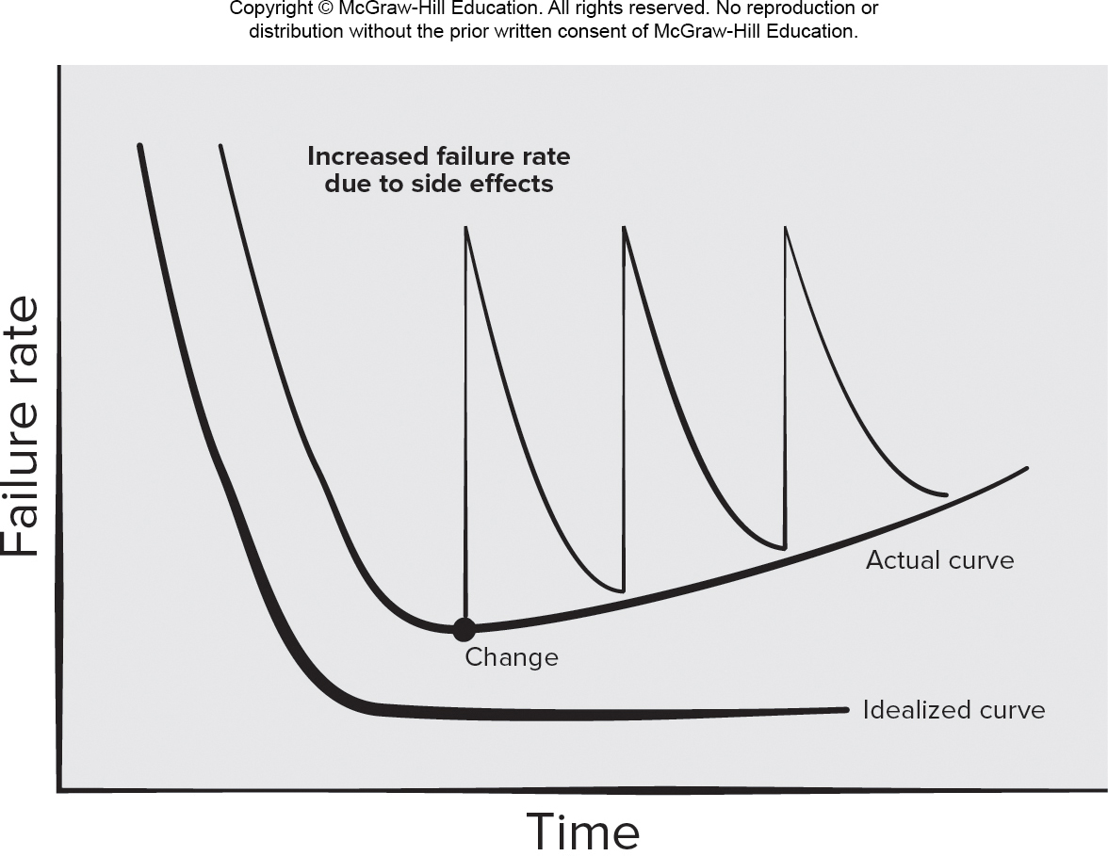
Maintenance & the Crisis
Notes:
Comment on how software can degrade over time, and the impact this may have on project failures.
Many projects are built on top of existing software and infrastructure.
Need for careful refactoring before adding new features.

Slide 59
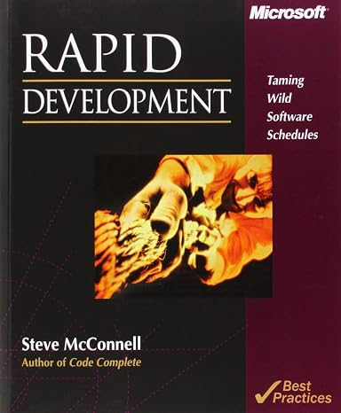
Why Do Projects Fail?
Are there root causes for project failures?
What research has been done about project failures?
Rapid Development: Taming Wild Software Schedules by Steve McConnell
  Identified a set of commonly repeated project mistakes
  https://stevemcconnell.com/articles/classic-mistakes/
  http://www.construx.com/uploadedfiles/resources/whitepapers/Software%20Development%E2%80%99s%20Classic%20Mistakes.pdf
Notes:
Ask students to nominate some suggestions as to why projects fail.
Introduce idea of software processes and project management as research fields.
Software development problems are so common that there is a book about the classic mistakes that people keep making.

Slide 60
Classic Mistakes
Abandoning Planning Under Pressure
Add People to a Late Project
Assuming Global Development has no Impact on Effort
“Code-like-Hell” Programming
Confusing Estimates as Targets
Developer Gold Plating
Excessive Multi-Tasking
Feature Creep
Notes:
From http://www.construx.com/uploadedfiles/resources/whitepapers/Software Development%E2%80%99s Classic Mistakes.pdf

Slide 61
Classic Mistakes
Friction Between Developers & Customers
Heroics
Inadequate Design
Insufficient Planning
Insufficient Risk Management
No Source Control
Lack of Effective Project Sponsorship
Lack of Stakeholder Buy-In
Lack of User Involvement
Notes:
From http://www.construx.com/uploadedfiles/resources/whitepapers/Software Development%E2%80%99s Classic Mistakes.pdf

Slide 62
Classic Mistakes
Letting a Team Go Dark
Noisy, Crowded Offices
Outsourcing to Reduce Costs
Overestimating Savings from New Tools or Methods
Optimistic Schedules
Planning to Catch Up Later
Politics Over Substance
Premature or Too Frequent Convergence
Push Me, Pull Me Negotiation
Notes:
From http://www.construx.com/uploadedfiles/resources/whitepapers/Software Development%E2%80%99s Classic Mistakes.pdf

Slide 63
Classic Mistakes
Requirements Gold Plating
Research-Oriented Development
Shortchanged Quality Assurance
Shortchanged Upstream Activities
Sliver-Bullet Syndrome
Subcontractor Failure
Switching Tools Mid-Project
Trusting the “Map” More than the “Domain”
Notes:
From http://www.construx.com/uploadedfiles/resources/whitepapers/Software Development%E2%80%99s Classic Mistakes.pdf

Slide 64
Classic Mistakes
Unclear Project Vision
Uncontrolled Problem Employees
Undermined Motivation
Unrealistic Expectations
Wasted Time on the “Fuzzy” Front End
Weak Personnel
Wishful Thinking
Notes:
From http://www.construx.com/uploadedfiles/resources/whitepapers/Software Development%E2%80%99s Classic Mistakes.pdf

Slide 65
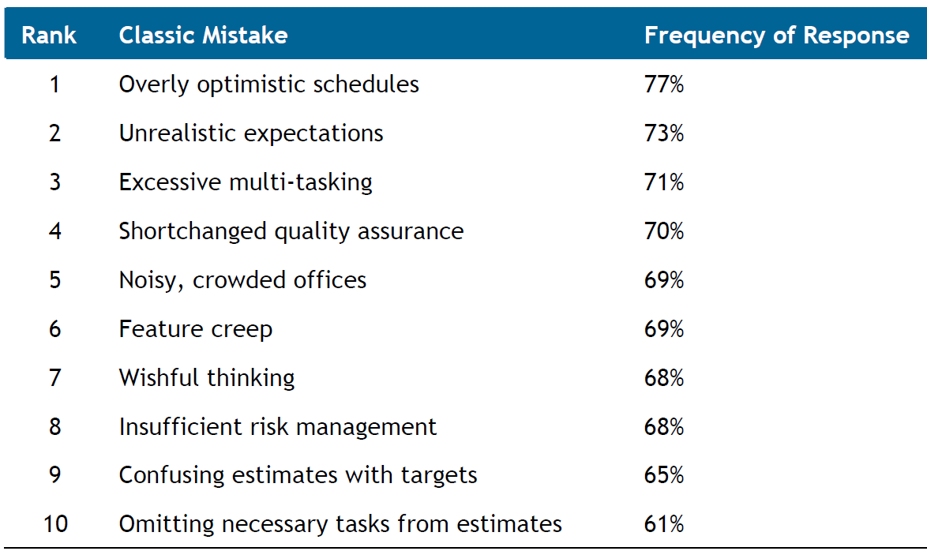
Most Frequently Reported Mistakes
Notes:
From http://www.construx.com/uploadedfiles/resources/whitepapers/Software Development%E2%80%99s Classic Mistakes.pdf

Slide 66
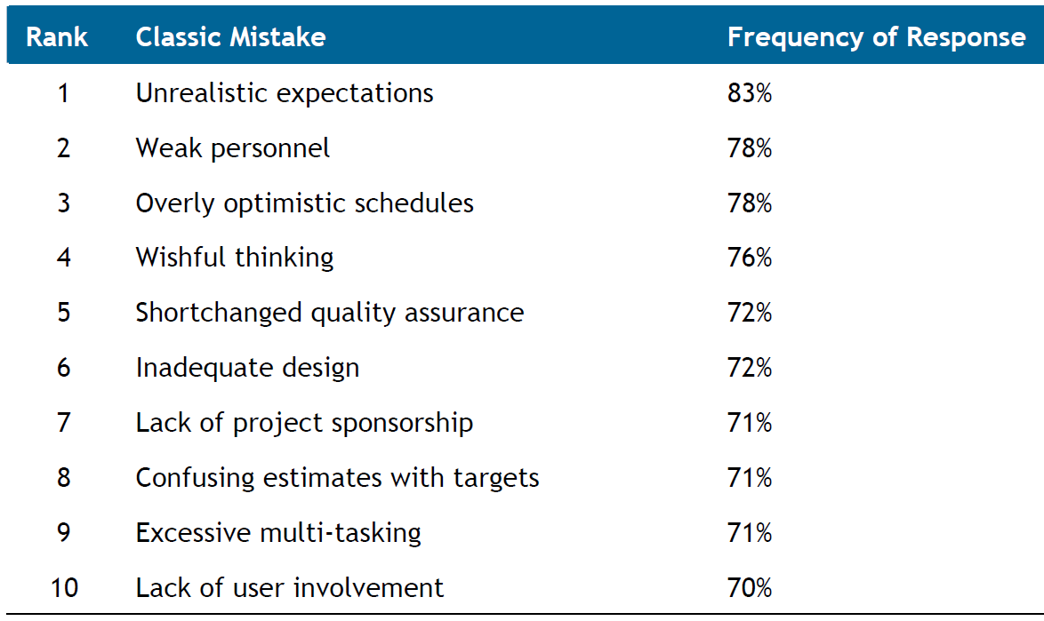
Mistakes Causing Catastrophic or Serious Consequences
Notes:
From http://www.construx.com/uploadedfiles/resources/whitepapers/Software Development%E2%80%99s Classic Mistakes.pdf

Slide 67
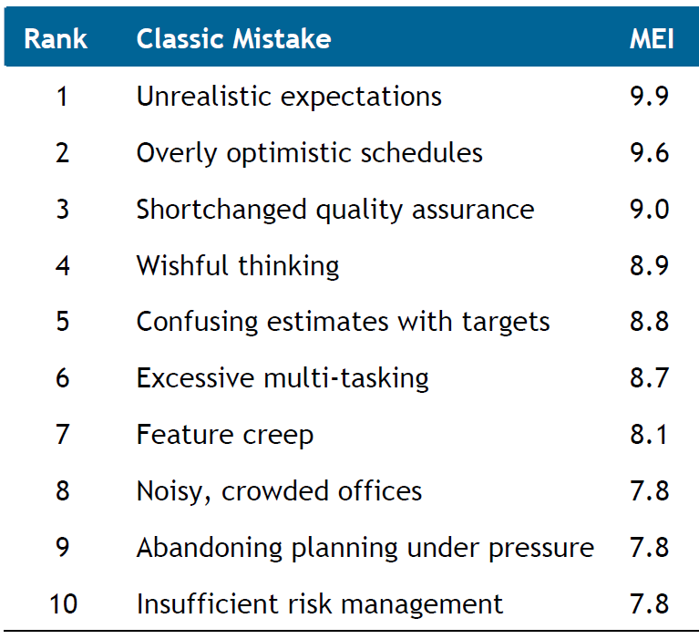
Mistake Exposure Index (MEI)
Notes:
Most problematic mistakes.
MEI is the approximate average frequency of each Classic Mistake multiplied by its average severity.
This ranges from 0 to 10, with 0 being the lowest exposure and 10 being the highest.
From http://www.construx.com/uploadedfiles/resources/whitepapers/Software Development%E2%80%99s Classic Mistakes.pdf

Slide 68
Why?
Why do people, managers, and teams keep making the same mistakes?
Notes:
Get students to discuss this question in groups of 3 or 4.
Give them about 10 minutes.
Have each group report back their ideas.
Get them to pause and reflect on how many of these “classic” mistakes have they done in their assignments.

Slide 69
Classic Mistakes
Undermined motivation
Uncontrolled problem employees
Noisy, crowded offices
Abandoning planning under pressure
Shortchanging upstream activities
Shortchanging quality assurance to improve development speed
Notes:
1996 Version of Classic Mistakes.

Slide 70
Classic Mistakes
Not controlling feature-creep
Silver bullet syndrome
Wasting time in the “fuzzy front end”
Insufficient user input
Overly aggressive schedules
Adding developers to a late project
Notes:
1996 Version of Classic Mistakes.

Slide 71
Successful Software Exists
“Computer systems are economically critical. … The effective functioning of modern economic and political systems depends on our ability to produce software in a cost-effective way.”
  Ian Sommerville, 1996
We’re interested in Software Engineering because we are building the software that shapes our society

Slide 72
Comparing Software Development Paradigms: 2013
Copyright 2014 Scott W. Ambler www.ambysoft.com/surveys/
Notes:
Get them to think about the implications of these numbers.

Slide 73
Comparing Delivery Paradigms
Copyright 2014 Scott W. Ambler www.ambysoft.com/surveys/
Notes:
Traditional and Ad Hoc had similar success rates on the previous slide.
Get students to suggest reasons for the difference seen on this slide.

Slide 74
WeChat Case Study
Read description of development team
  https://baike.baidu.com/en/item/WeChat%20Development%20Team/2579698
Started as a team of 12 in 2010
  700 by 2014
  Estimated to be over 1400 now
Discuss
  Team growth – How do you think they managed it?
  Flat organisational structure – How could they maintain consistency?
  Competitive team environment – What are benefits and drawbacks?
  2025 restructure – Implications for managing the platform?

Slide 75
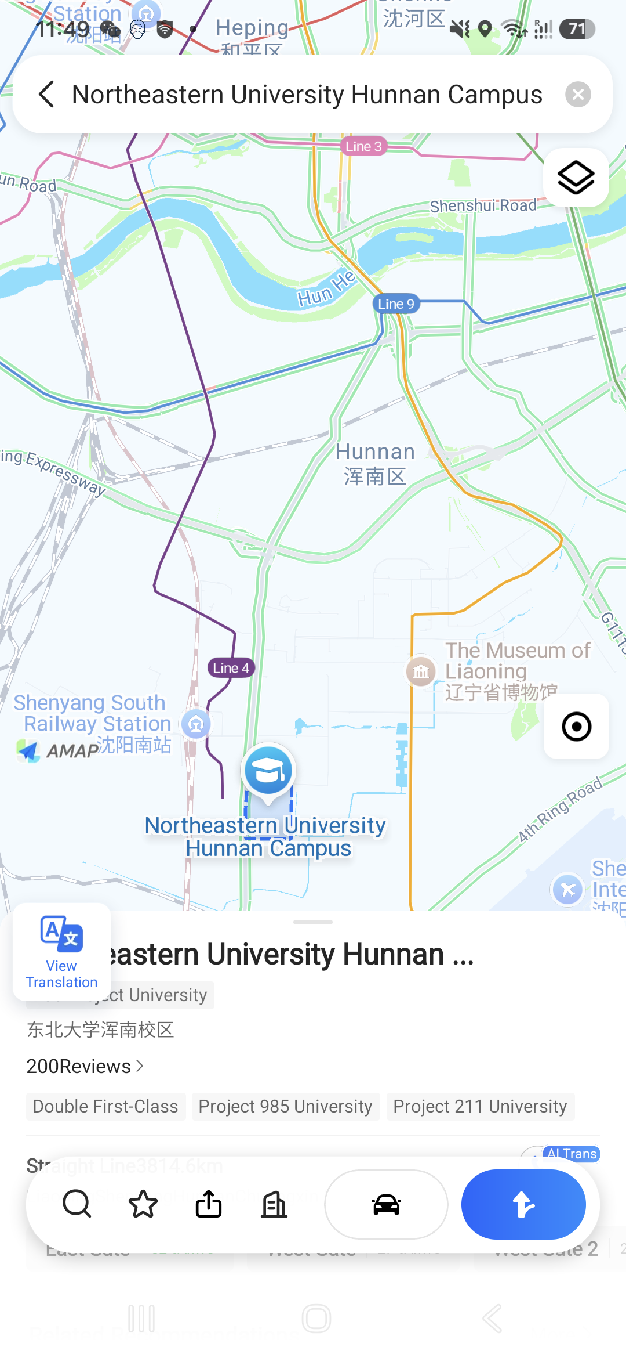
Amap Planning
How many teams were needed to build Amap?
  Don’t worry about each teams’ size
  Don’t worry about how long they need to implement their work
What features does it have?
How many are built by Alibaba?
How many are external services?
  Each service still needs to be integrated into Amap
Notes:
Get them to think about the first point for a couple of minutes.
Then show them point 2 and ask them to list out all of Amap’s features.
Doesn’t really matter if they get them all, just that they build a good-sized list.
Hint that they want at least one team per feature.
Big features may need more than one team.
Any sophisticated external service will need a team to integrate it, but at least they don’t have to build it.
Some numbers
2020: 100 front-end developers
Alibaba: 25,000 engineers
Side note:
UQ team built an AI-powered English overlay for Amap, 3 weeks before Amap released its English interface.

Slide 76
Ethics

Slide 77
Ethics
Software engineering involves wider responsibilities than simply the application of technical skills
Software engineers must behave in an honest and ethically responsible way
  If they are to be respected as professionals
Ethical behaviour is more than simply upholding the law
  Requires following a set of principles that are morally correct

Slide 78
Professional Responsibility
Confidentiality
  Engineers should normally respect the confidentiality of their employers or clients irrespective of whether or not a formal confidentiality agreement has been signed
Competence
  Engineers should not misrepresent their level of competence
    Should not knowingly accept work which is outside their competence

Slide 79
Professional Responsibility
Intellectual property rights
  Engineers should be aware of local laws governing the use of intellectual property such as patents, copyright, etc.
  They should carefully ensure that the intellectual property of employers and clients is protected
Computer misuse
  Engineers should not use their technical skills to misuse other people’s computers
    Misuse ranges from relatively trivial (e.g. playing games on an employer’s machine) to extremely serious (e.g. dissemination of viruses)

Slide 80
ACM/IEEE Code of Ethics
Professional societies have cooperated to produce a code of ethical practice
Members sign up to the code of practice when they join
Contains eight principles related to the behaviour of and decisions made by professional software engineers
  Including practitioners, educators, managers, supervisors and policy makers, as well as trainees and students

Slide 81
Code of Ethics Rationale
Computers have a central and growing role in commerce, industry, government, medicine, education, entertainment and society at large. Software engineers are those who contribute by direct participation or by teaching, to the analysis, specification, design, development, certification, maintenance and testing of software systems.
Because of their roles in developing software systems, software engineers have significant opportunities to do good or cause harm, to enable others to do good or cause harm, or to influence others to do good or cause harm. To ensure, as much as possible, that their efforts will be used for good, software engineers must commit themselves to making software engineering a beneficial and respected profession.

Slide 82
ACM/IEEE Code of Ethics
Software Engineering Code of Ethics and Professional Practice
ACM/IEEE-CS Joint Task Force on Software Engineering Ethics and Professional Practices
PREAMBLE
The short version of the code summarizes aspirations at a high level of the abstraction; the clauses that are included in the full version give examples and details of how these aspirations change the way we act as software engineering professionals. Without the aspirations, the details can become legalistic and tedious; without the details, the aspirations can become high sounding but empty; together, the aspirations and the details form a cohesive code.
Software engineers shall commit themselves to making the analysis, specification, design, development, testing and maintenance of software a beneficial and respected profession. In accordance with their commitment to the health, safety and welfare of the public, software engineers shall adhere to the following Eight Principles.

Slide 83
Ethical Principles
PUBLIC - Software engineers shall act consistently with the public interest.
CLIENT AND EMPLOYER - Software engineers shall act in a manner that is in the best interests of their client and employer consistent with the public interest.
PRODUCT - Software engineers shall ensure that their products and related modifications meet the highest professional standards possible.
JUDGMENT - Software engineers shall maintain integrity and independence in their professional judgment.
MANAGEMENT - Software engineering managers and leaders shall subscribe to and promote an ethical approach to the management of software development and maintenance.
PROFESSION - Software engineers shall advance the integrity and reputation of the profession consistent with the public interest.
COLLEAGUES - Software engineers shall be fair to and supportive of their colleagues.
SELF - Software engineers shall participate in lifelong learning regarding the practice of their profession and shall promote an ethical approach to the practice of the profession.

Slide 84
Ethical Dilemmas
Disagreement in principle with the policies of senior management
Your employer acts in an unethical way and releases a safety-critical system without finishing the testing of the system
Participation in the development of military weapons systems or nuclear systems
Notes:
Get students to discuss each dilemma and consider how they might respond.
Get them to explain why their initial response is, or is not, ethically appropriate.
Spend about 10 minutes per dilemma.

Slide 85
Ethics Case Study
As an analyst at a big-data consultancy firm
You are conducting research on social media activit
You collect posts from the past two years across 10,000 users
  Ensuring their identities remain hidden in any published results
You use machine learning (ML) techniques to process over 200,000 posts
Notes:
Treat this as a fuller case study to go into more depth.
See Case Study 3 in the Resources Directory for more detail.

Slide 86
Ethics Case Study (cont.)
You then acquire 100 million anonymised posts from 5 million users over two years
You later discover that the usernames in reposts weren't removed
  Compromising anonymity
Your data science tools and ML system can identify many usernames in this supposedly anonymised data
This also shows that the additional data greatly enhances the value of your research

Slide 87
Ethics Case Study Options
Scrub the data to remove usernames and then run your analysis on properly anonymised data
Immediately discard the identifiable data, advise the supplier, and request the data again
Research the supplier’s data management policies. If they’re in breach of their policy, show them the identifiable data, requesting that it be replaced with anonymised data
Run the analysis just to see what it would produce but then discard the identifiable data.
Run the analysis and produce and publish the results
  Not mentioning the data breach
Notes:
Get students to debate the different options and justify why some are or are not ethical.

Slide 88
Key Points
Software engineering is an engineering discipline that is concerned with all aspects of software production
Essential software product attributes are maintainability, dependability and security, efficiency, and acceptability
The high-level activities of specification, development, validation and evolution are part of all software processes
Fundamental concepts of software engineering are applicable to all types of software development

Slide 89
Key Points
There are many different types of systems, and each requires appropriate software engineering tools and techniques for their development
Software engineers have responsibilities to the engineering profession and society
  They should not simply be concerned with technical issues
Professional societies publish codes of conduct which set out the standards of behaviour expected of their members

